Slide 1
SEND, Governance and Covid
Key points about the intersection of these
Max Fishel

Slide 2
SEND
SENDCo
Notes:
The "D" often disappears in conversations and texts about SEND. Making sure it is always present, especially in SENDCo, is a reminder that disabilities always need to be taken into account.

Slide 3
The SEND Code states that governing boards should have a governor or trustee with specific oversight of the school’s arrangements for SEND. Some schools choose to appoint a committee to oversee SEND.
NGA – SEND guidance © National Governance Association 2021
Notes:
The need to have a governor or committee with a responsibility for SEND. This person, or group, needs to understand the SEND Code of Practice, and the relevant ramifications of the Equality Act 2010.

Slide 4
Governors can carry out an internal SEND audit
SEND Governance – SEND Governance Review Guide
Notes:
For information. The awareness of the existence of this document seems quite low, and it can be a useful starting point if needed. It is always useful to review provision in any case.

Slide 5
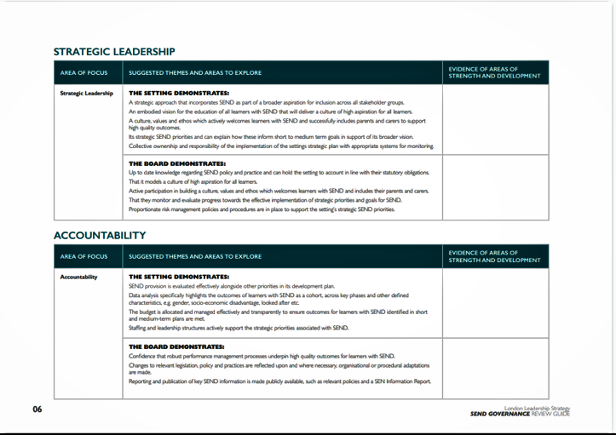
Notes:
A page from the Review.

Slide 6
Context of Covid- resilience of system already low
Some CYP with SEND also receive therapeutic care in school, e.g., SALT, OT, school nurse
Some schools not allowing these practitioners in even though some CYP have returned
Issues around accessibility of online materials produced by schools
Coronavirus Act reduced right to access LA support for some with disabilities
High frequency of changes has high impact on some CYP, e.g., those with autism – need extra support in re-entering school
Staff need training on how to support CYP remotely
Has AT been supplied to CYP?
CYP may use equipment at school which can't use when school shut or they can't get in
UNCRPD Art 24
Currently no legal framework ensuring accessibility, provenance or quality of online learning offer
Notes:
Commentary about points relevant to Covid context and SEND provision. Gives overview which governors will need to be aware of.
UNCRPD Art 24 = UN Convention on Rights of Persons with Disabilities Article 24 – right to education. UK is signatory.

Slide 7
Questions for governors of SEND to ask in the context of Covid-19
For pupils with SEND:
How many (number and %) are actually attending? Consequences of this?
Contact between SENDCo and parents/pupils?
Tell us how your remote learning offer is accessible and inclusive
How is Covid affecting in-school provision?
How do you support the wellbeing of pupils?
What training is in place for teachers and TAs who work with these pupils?
What lessons have been learned for any future pandemic/similar situation?
What support have you had from the LA (if MAT, how does your school interact with LA to access support)?
Have you requested support from specialist services?
Notes:
Not an exhaustive list and generally questions will be tailored to individual situations. Important that governors appreciate that school leaders, staff, pupils and parents are now exhausted and fed up.

Slide 8
"Catch up"?
Already existing inequality exacerbated by pandemic
Suggest recalibration of KPIs and "progress"
Need to prioritise wellbeing and mental health of pupils over academic learning; WB & MH are core needs for everyone, especially young pupils who don't have a repertoire of coping strategies; if not provided for, no learning can occur
Use DfE funding creatively – let children play!
Notes:
Many types of non-measurable progress, should be individualised, meaningful, acknowledged, celebrated
Concept of core needs essential for governors to grasp, esp for pupils with SEND

