Slide 1
The Importance of Governance at a time of Crisis
Julia Skinner @theheadsoffice

Slide 2
3 core functions of a governing board (there may be a fourth!)
Ensure clarity of vision, ethos and strategic direction
Hold executive leaders to account for the educational performance of the organisation and its pupils and performance management of staff
Oversee the financial performance of the organisation and making sure its money is well spent.

Slide 3
Effective Governance
Challenge
Support

Slide 4
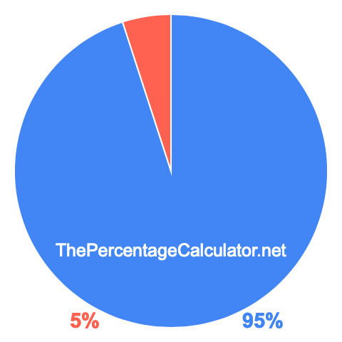
Governance in a crisis
Challenge
SUPPORT

Slide 5
What do they look like in a crisis?

Slide 6
Ensure clarity of vision, ethos and strategic direction
Decisions about which pupils come in
Covid Risk assessment
Safeguarding
Health & safety
Wellbeing of staff
Wellbeing of leaders

Slide 7
Hold executive leaders to account for the educational performance of the organisation and its pupils and performance management of staff
Classroom organisation
What are they learning?
What is the online offer?
How are they accessing it?
If staff are not needed in person, what are they doing?

Slide 8
Oversee the financial performance of the organisation and making sure its money is well spent.
Schools Financial Value Standard submission
Budget approval and submission
Budget Forecast Outturn Return (Academies)
Three-year forecast submission (Academies)
Recruitment for September 2020
Costs incurred over the crisis
Checking for fraud

Slide 9
Approach of the Trust
Establish a committee to oversee & act as decision making body
Close working relationship between CEO, HTs, Chairs & V Chairs
Robust challenge from local boards communicated to the Trust
Standardisation across the Trust in communications, CPD,
Collaborative approach to remote learning
Clevedon Learning Trust / Educate Together Academy Trust

Slide 10
Dartmoor Academy Trust Covid Learning:
Agility of Governance has been a clear strategic benefit of working within a MAT; additional support given to operations in a highly difficult time
Trust system was driving the refinement of information and guidance filtered through the confidence of a collective approach which helped to ensure that the moral lens of the trust could be translated into highly effective risk assessment processes and communication
Sounding board for the Executive team- at many times a shoulder to lean on in a space where other professional networks didn’t have the bandwidth or ability to support- we were all, as Executives, in the same place

Slide 11
Dartmoor Academy Trust Covid Learning – contd:
The focus on Civic leadership- the significant role we have within our localities to really connect with wider services. It showed us not to get to caught up in the immediacy of reforms but instead to relentlessly build the networks for each of our schools. Networking the networks means we have consciously “seen” the local system through new eyes and through a renewed focus on genuine change
We require unprecedented leadership and there is a greater emphasis on how we hold trust for and with the children
Dan Morrow – CEO, DMAT

Slide 12
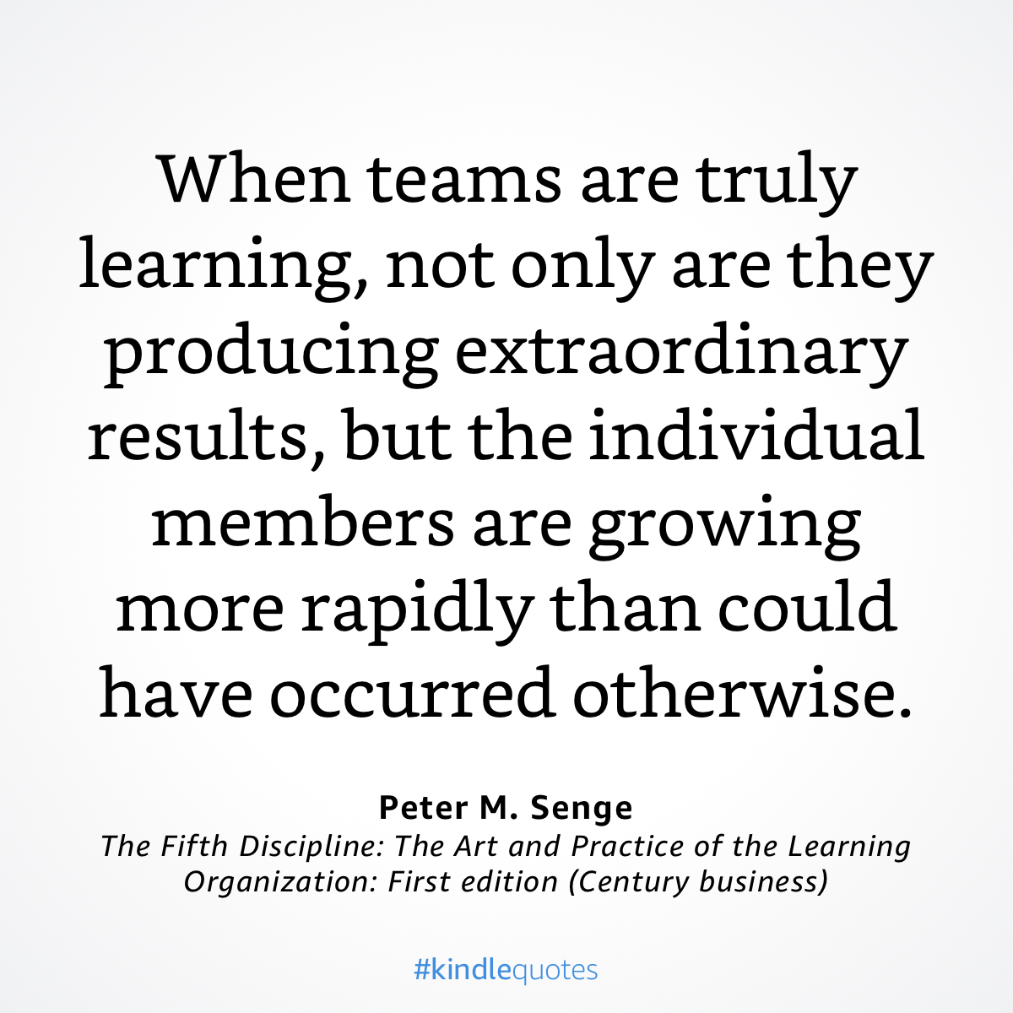
Peter M. Senge
The Fifth Discipline: The Art and Practice of the Learning Organisation: first edition (Century business)

Slide 13
Questions to consider
What role should governance play in a crisis?
How can you judge the impact?

