Slide 1
‘Governing and Governance: Multi-Academy Trust vs Maintained contexts' governing’
Dr Deborah Outhwaite
@deb_outhwaite
Fabian Meeting
Tuesday 22nd February 2021

Slide 2
Affiliations:
EdD Supervisor - University of Liverpool Online
Director - DTSA
Vice-Chair BELMAS
Regional Lead @WomenEd
Fellow: Chartered College of Teaching and RSA
Senior Fellow: HE Academy

Slide 3
Recent times…
Creation of Academy Trusts - outside Local Authority (LA) control, directly accountable to DfE
Neo-Conservative encouragement of Multi-Academy Trusts (MAT expansion)
Running down of LA budgets
System created is a ‘Middle Tier’ with two fold accountability structures, and double the costs…
Trustee and Governor roles critical in System Leadership but are often unpaid and much has moved from democratic accountability to unpaid and appointed posts…

Slide 4
System Leadership
The DfE consider all those who work in senior roles in the education to be System Leaders (ie leaders in the education system)
The term has gained more in usage since roles and responsibilities have become less clearly delineated, to cover:
DfE spend through agencies (eg: ESFA)
Local Authorities
Teaching School Hubs from Sept 21 (TSHs)
Stand Alone and Multi-Academy Trusts (SATs and MATs, particularly including their central teams)

Slide 5
The changing nature of the Middle Tier in England
Changes in current system:
Creation of MATs in last decade
Huge variance in types of MATs
LAs still keep Statutory Duties
Issues that ‘The Middle Tier’ give rise to…
(Bubb et al, 2019)
Pay inequalities
Variance on Trustee and Governor roles and expectations…

Slide 6
‘Middle tier’ functions in England, source Bubb et al (2019)
Finance | Accountability | Access | People
Allocating finances - ESFA, LA, MAT Accounting - ESFA, LA, MAT Financial monitoring - ESFA, LA, MAT, Dioceses Finance returns - ESFA, LA, MAT Intervening in financial issues - ESFA, LA, Diocese Audit - LA, MAT Allocating grants - ESFA Bidding for grants - LA, MAT | Monitoring standards - RSC, LA, Dioceses, MAT School improvement - NCTL, LA, MAT, Complaints - LA, ESFA, Dioceses External Reviews - ESFA, RSC, LA, MAT, Dioceses Governance support - LA, MAT, NCTL, Dioceses Intervention - LA, RSC, Dioceses Liaison with DfE agencies - MAT, LA, Diocese | Admissions & appeals - LA, MAT, Dioceses Curriculum - MAT, LA, Dioceses SEN - LA Educational welfare - LA Place planning - LA Buildings & grounds - MAT, LA, Dioceses | Recruitment - NCTL, MAT, LA Training and development - NCTL, MAT, LA Initial teacher training - NCTL NQT induction - NCTL, MAT, LA, Dioceses HR - LA, MAT, Dioceses NB: NCTL now disbanded (March, 19) so now directly part of DfE.
Notes:
Democratic accountability? Accountability here is upwards or hierarchical accountability – horizontal a/c? Place of SI? Strategic local planning?

Slide 7
The changing nature of the Middle Tier in England
Differences in current system:
Flexibility in MATs:
Recovery Programme
Issues raised through this on-going
Trust Accountability as employer
Variance in LA support
State of LAs to be able to deal with pressures…
Links into Public Health England (now being disbanded)
Resources (Laptops/Dongles) coming through LA

Slide 8
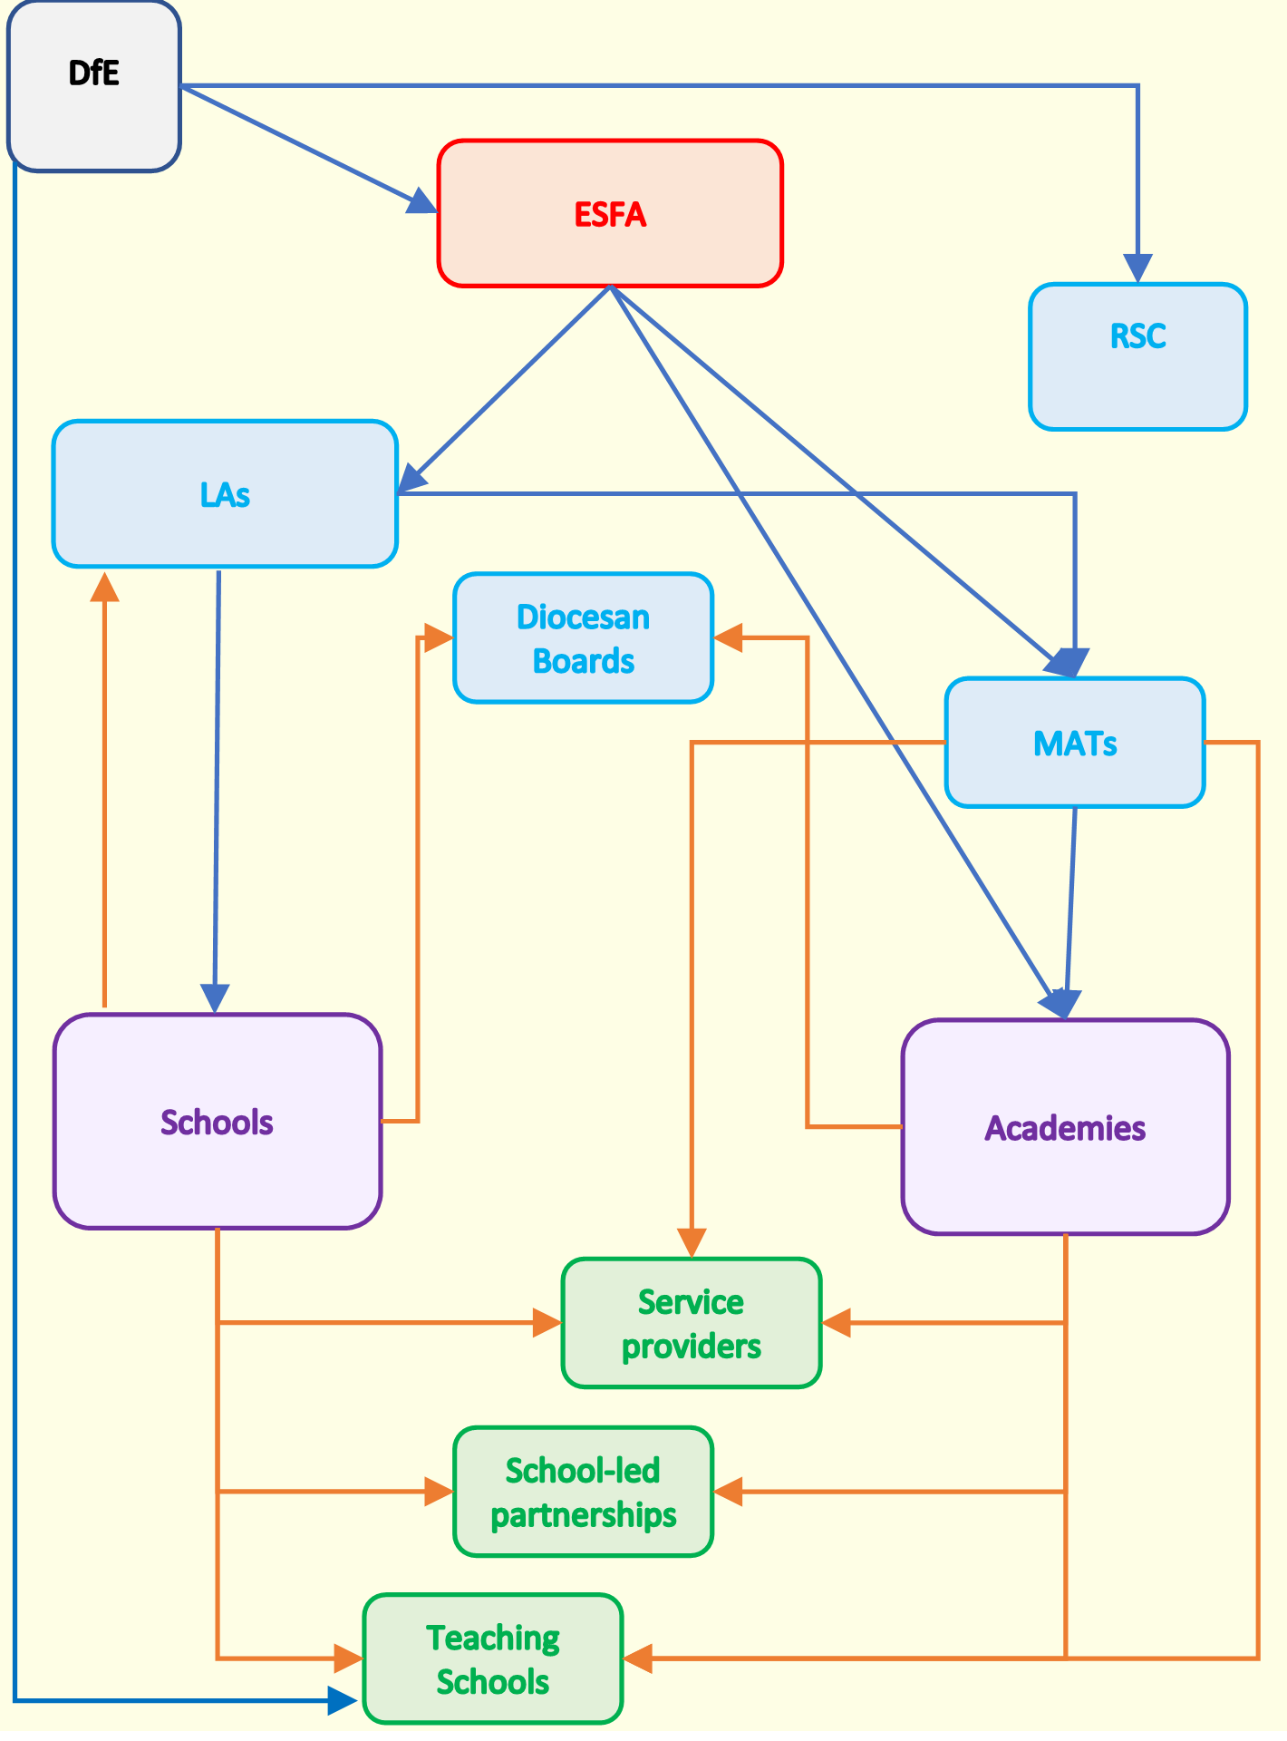
How funding for the Middle Tier flows
Functions:
Support and Accountability
Support
Accountability
Flows: = DfE funding
= Functions purchased
Source: Bubb et al (2019).

Slide 9
The changing nature of the Middle Tier in England
Expectations in system:
Variations between MATs and LAs
Issues that ‘The Middle Tier’ give rise to…
(Bubb et al, 2019)
Parental expectations (routines/ paid work)
Governmental Advice (economic led vs public health needs)
Trustees and Governors have duty of care to keep both staff and students safe… (H&S)

Slide 10
The changing nature of the Middle Tier in England
Using wealth of resources:
Staff are our most important resource:
Where does their support come from?
NGA/ Forum/ CST/ ASCL/ NAHT
Informed CPLD – huge variance
Understanding our ‘catchment’ issues
Research in an ever-changing landscape…
Diversity, always been important, but post #BLM now need to show visibility (NCVO)

Slide 11
The changing nature of the Middle Tier in England
Defining what’s important?
Being congruent with values – what are they?
Post-Covid: Trauma first, learning second
Understanding economic imperative
Demands on Mothers: systemic inequalities
Primary and Secondary: different learning curves
Support your leaders, it’s lonely, Trust/GB role to be the challenge, when the time is right…

Slide 12
Dual system here to stay?
The 8 Regional Schools Commissioners (RSCs) and the National School Commissioner, have huge power/influence
The new 87 TS Super Hubs will lead on:
ITE and Mentoring, national strategies such as the ECF roll out
LPD, with the new-style NPQs
SI and S2SS… using NLGs and NLEs, changed…
Role of LAs not being challenged, remains unchanged statutorily but heavily eroded…

Slide 13
How do we move forward?
The anti-academies arguments (Gunter and Courtney, 2020) are only part of the picture, see Cruddas 2020 CST paper…
Labour will not be back in office until 2029:
Secondaries: 80%
Primaries: increasing from a third…
Will be far more by 2029…
Role of LAs eroded but have played a role in Covid…

Slide 14
How do we move forward effectively?
Need to realise where we will be by 2029, so that policy can run from where we are, not where we may like to be…
Decisions need to be taken around how the Middle Tier is resolved
All schools to academise?
New ways forward for a residue form of LA?
How to ensure equity of provision (particularly for SEND) in a competitive, marketized system that is paid for by the state?

Slide 15
References
BELMAS Governance and Governing RIG: http://www.belmas.org.uk/RIG-GG/Overview
Bubb et al (2019) ‘The Middle Tier’: www.sarabubb.com/middle-tier/4594671314
Carpenter, B. (2020) Recovery Curriculum: https://barrycarpentereducation.com/2020/04/23/the-recovery-curriculum/
Core Content Framework, DfE, 2019,: https://assets.publishing.service.gov.uk/government/uploads/system/uploads/attachment_data/file/843676/Initial_teacher_training_core_content_framework.pdf
Confederation of School Trusts: https://cstuk.org.uk/
Cruddas, L. (2020) Systems of Meaning: Three Nested Leadership Narratives for School Trusts, Confederation of School Trusts.
Early Career Framework, DfE, 2019: https://www.gov.uk/government/publications/early-career-framework-reforms-overview/early-career-framework-reforms-overview
Gunter, H. and Courtney, S. (2020) A new public educative leadership? Management in Education, 1-5.
National Governance Association: https://www.nga.org.uk/Home.aspx
National Council for Voluntary Organisations: https://knowhow.ncvo.org.uk/governance/improving-your-governance-practice/trustee-diversity/how-to-increase-diversity-among-trustees
Teaching School Super Hubs Announcement, DfE, 2020: https://www.gov.uk/government/news/struggling-schools-set-for-specialist-support

Slide 16
Suggested Reading
Bubb, S, Crossley-Holland, J, Cordiner, J, Cousin, S and Earley, P (2019) Understanding the Middle Tier: Comparative Costs of Academy and LA-maintained Sectors. London: Sara Bubb Associates
Bush, T., (2019) Navigating structural change in the English schools’ system, Educational Management Administration & Leadership, Vol. 47(3) 329–330:
https://journals.sagepub.com/doi/pdf/10.1177/1741143219831490
Cousin, S. (2019) System Leadership Policy and Practice Bloomsbury
Fullan, M. (2015) ‘Leadership from the Middle: A system strategy’ Education Canada. December 2015 pp 22-26
Greany, T. and Higham, R. (2018) Hierarchy, Markets & Networks: Analysing the ‘self-improving school-led system’ in England and the implications for academies. London: UCL IOE Press.
Simkins, T., Coldron, J., Crawford, M. and Maxwell, B. (2019) Emerging schooling landscapes in England: How primary system leaders are responding to new school groupings Educational Management Administration & Leadership 2019, Vol. 47(3) 331–348: https://journals.sagepub.com/doi/pdf/10.1177/1741143217751079
West, A., and Wolfe, D. Academies, the School System in England and a Vision for the Future (2018) http://www.lse.ac.uk/social-policy/Assets/Documents/PDF/Research-reports/Academies-Vision-Report.pdf

Slide 17
Questions?

