Slide 1
Fabian Society
Governance and Governing Event
Emma Knights OBE, Chief Executive,
National Governance Association

Slide 2



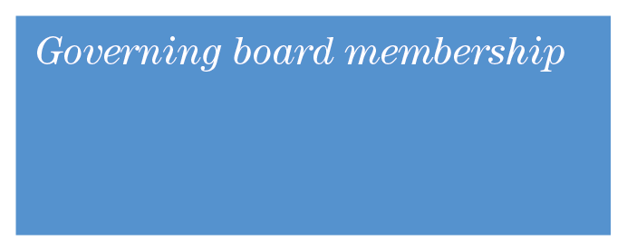
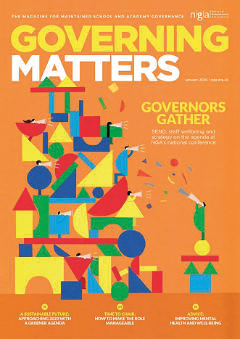

NGA is a membership organisation
NGA is an independent, not-for-profit charity representing and supporting governors, trustees and clerks of state schools in England
Our aim is to improve the educational standards and wellbeing of young people by increasing the effectiveness of governing boards and promoting high standards
We are expert leaders in school and trust governance, providing information, advice and guidance, professional development and e-learning
STANDARD governing board £97
GOLD governing board £275
MATs on sliding scale
www.nga.org.uk/membership
© NGA 2020

Slide 3

What governors & trustees told NGA during lockdown 1 were priorities
The top six concerns overall were:
Balancing the budget: 40%
Staff wellbeing including workload: 36%
Ensuring a broad and balanced curriculum: 28%
Improving attainment: 28%
Pupil wellbeing: 28%
Support for pupils with SEND: 22%
For more detail: see Annual-school-governance-survey/2020

Slide 4
Some key COVID-19 specific issues raised by governors & trustees
Decision-making pressure – using chairs action while keeping the full board engaged
Risk assessments – appropriate level of detail; government vs local advice; 360 degrees
Liability concerns – seriousness of employer responsibilities
Chairs’ workload – many discussions to be involved in is time consuming
Volume of guidance – concern for burden on headteachers & other leaders
Supporting executive leaders – looking out for wellbeing while maintaining objectivity
Stakeholder engagement – stronger communications with anxious communities
Re-balancing support and challenge
Remote education – what does good look like?
Vision and culture – being inclusive and ambitious; when to revisit strategy?
Local governance within MATs – reinstatement or changes, clarity of accountability

Slide 5

Governance in MATs: the challenge
Main challenge is not actually the switch to charity law
  It’s the scale of responsibility of more than once school
  It’s knowing who much the trustees and the executive should delegate to academy level and how much the board of trustees must see and decide themselves
Local governance: over the years the role of academy committees (LGBs) have been controversial with some predictions of their demise
  But in 2020 we see their existence in some form in almost all MATs
  Increasing numbers of those governing academies locally are positive with 73% agreeing that their voices were heard by executive leaders and trustees in the decision making pricess (up from 57%)
Flawed model: - the members of trusts are too few and too powerful
  too many trusts still rely on people serving on more than one layer of governance

Slide 6
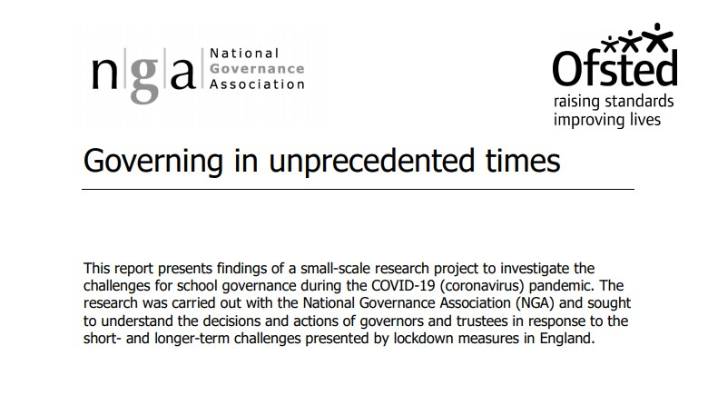


Slide 7
Some positive legacy from COVID
Some new ways of governing will be retained in part: improving attendance & efficiency
The central importance of schools to their community:
  but also the importance of place to school policy and school improvement
Better collaboration across localities, including with other agencies
Is there evidence that being in a formal group of schools (a MAT or federation) has provided support, in particular to smaller schools? : Ofsted blog
On the other hand, some concerns have been exacerbated, especially:
Disadvantage gap
Well-being of pupils
Potentially the recruitment & retention of school leaders

Slide 8
The future – but avoiding major predictions
Stronger relationships with parents
Renewed emphasis on different groups of children with particular challenges and working across the locality for solutions
Curriculum to remain central stage: and governing boards to become more confident in those discussions
School improvement via continuous professional development
More diverse boards: but we do not underestimate the relentlessness of recruitment
More sharing of tasks and responsibility: co-chairs & two vice-chairs
BUT what about £££s?
In part the future of schools is in the hands of governing boards
Not everything will change or should change!

Slide 9
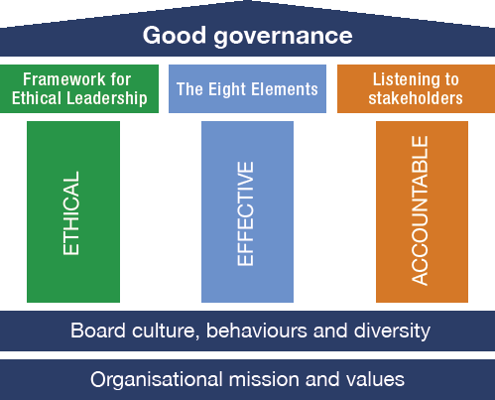
Lots doesn’t change www.nga.org.uk/Knowledge-Centre/Good-governance

Slide 10

Everyone on Board

